Slide 1


Design and Evaluation of a Retrieval-Augmented Generation System for Question Answering over Course Materials
Guided By
Dr T Kumaragurubaran
Presented by:
N.R.YASASWINI (192425119)
B.VANI(192472348)

Slide 2
INTRODUCTION
Retrieval-Augmented Generation (RAG) combines information retrieval and Large Language Models (LLMs) for question answering.
The system retrieves relevant information from course materials such as PDFs, notes, and textbooks.
Retrieved content is provided to the language model to generate accurate and context-based answers.
It helps students quickly find relevant information without manually searching through large study materials.
The system can improve learning efficiency, accessibility, and personalized academic support.

Slide 3
LITERATURE SURVEY
Author & Year | Focus | Key Findings | Gaps
Wang et al. (2024) | RAG Techniques | Improved retrieval and answer quality. | Retrieval efficiency needs improvement.
Alawwad et al. (2025) | Textbook QA | RAG improves answers from large course materials. | Long-context reasoning remains challenging.
Li et al. (2025) | RAG in Education | Supports interactive learning and assessment. | Hallucination and retrieval gaps remain.
Guan et al. (2026) | Educational RAG | Improved relevance and grounding in course content. | Better retrieval and evaluation are needed.

Slide 4
PROBLEM STATEMENT
Students often need to search through large volumes of course materials to find answers.
Traditional keyword-based search may return information that is irrelevant or incomplete.
General-purpose AI models may generate answers that are not based on the student's actual course content.
LLMs can sometimes produce hallucinated or factually incorrect information.
Therefore, there is a need for a system that provides relevant, reliable, and course-specific answers.

Slide 5
OBJECTIVE
To design a course-specific RAG-based Question Answering system.
To efficiently retrieve relevant information from large course documents.
To generate accurate and context-aware answers using retrieved content.
To reduce hallucinations by grounding responses in the provided materials.
To improve the speed and convenience of accessing educational information.
To evaluate the system's performance using suitable retrieval and generation metrics.

Slide 6
EXISTING SYSTEM
Manual document search – Students read and search through PDFs, notes, and textbooks manually.
Keyword-based search – Finds documents or passages containing specific keywords but may lack contextual understanding.
Traditional Question Answering systems – Provide answers from predefined datasets but have limited flexibility.
General-purpose Chatbots/LLMs – Generate natural-language answers but may not be grounded in specific course materials.

Slide 7
PROPOSED SYSTEM
Develop a RAG-based Question Answering system specifically for course materials.
Upload and process course documents such as PDFs, lecture notes, and study materials.
Divide documents into smaller meaningful text chunks.
Convert the chunks into vector embeddings and store them in a vector database.
Retrieve the most relevant content based on the user's question.
Provide the retrieved context to an LLM to generate a clear and relevant answer.
Evaluate the system based on retrieval accuracy, answer quality, relevance, and response time.

Slide 8
ALGORITHM USED
Viewed rag.py:1-481
Viewed ingest.py:1-80
Here are the algorithms and techniques used in this project:
1. BGE Embeddings (`BAAI/bge-small-en-v1.5`) — Dense vector embeddings for semantic similarity via SentenceTransformer (33M params)
2. Cosine Similarity Search — ChromaDB vector store retrieves top-K chunks by cosine distance against the query embedding
3. Query Expansion — An LLM rewrites the user question into 2 alternate phrasings to improve recall
4. BM25 Re-ranking (`BM25Okapi`) — Classic sparse keyword-matching algorithm re-scores the retrieved chunks; final ranking is a 60/40 blen* of semantic score + BM25 score
5. RAG (Retrieval-Augmented Generation) — The core pipeline: retrieve relevant chunks → inject as context → generate a grounded answer via LLM

Slide 9
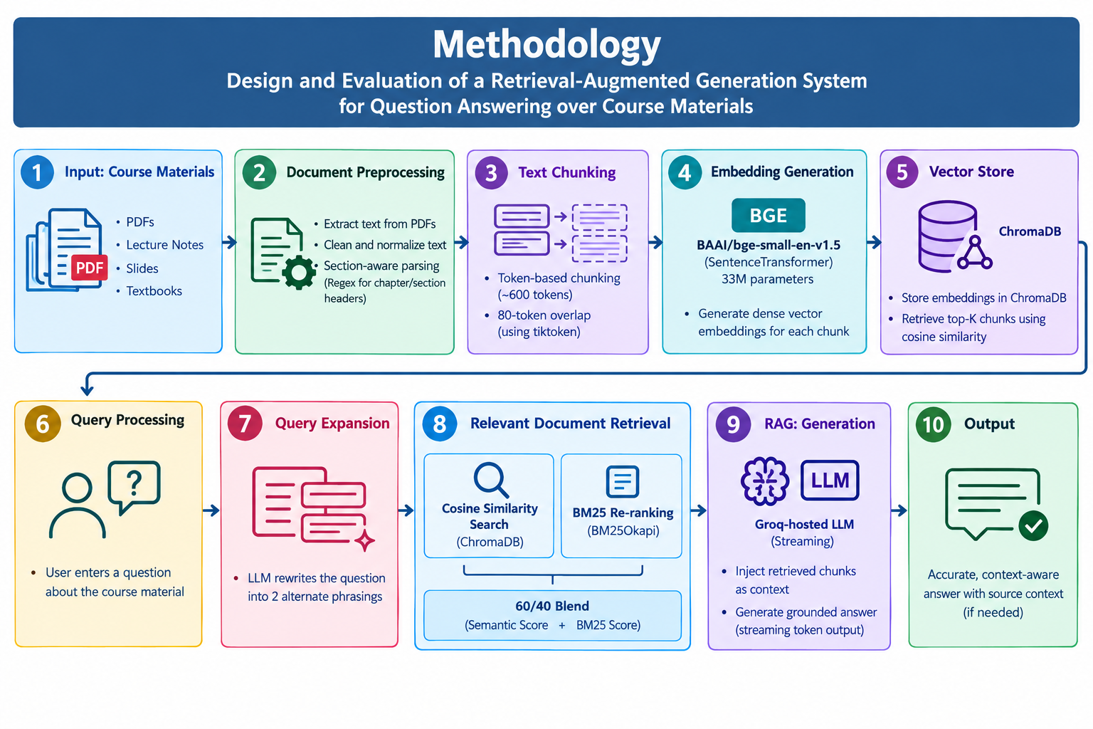
METHODOLOGY

Slide 10
MODULE 1
Document Processing & Retrieval Module
Processes course materials such as PDFs, notes, and textbooks into a suitable format for retrieval.
Splits documents into smaller meaningful text chunks for efficient searching.
Converts the processed text into vector embeddings that capture the meaning of the content.
Retrieves the most relevant information based on the user's question.
Provides the retrieved content as context for generating accurate and course-specific answers.

Slide 11
MODULE 2
Answer Generation & Evaluation Module
Generates answers based on the relevant content retrieved from the course materials.
Produces clear, accurate, and context-aware responses to user questions.
Evaluates answers based on accuracy, relevance, completeness, and coherence.
Grounds the generated answers in the provided course content to reduce hallucinations.
Uses evaluation results and user feedback to improve the overall answer quality.

Slide 12
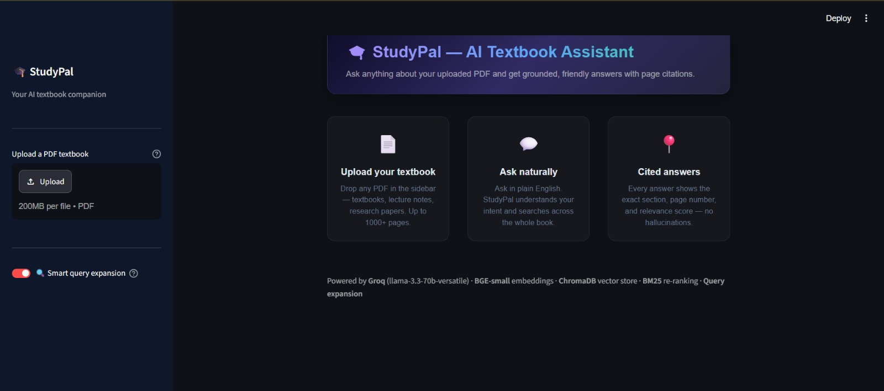
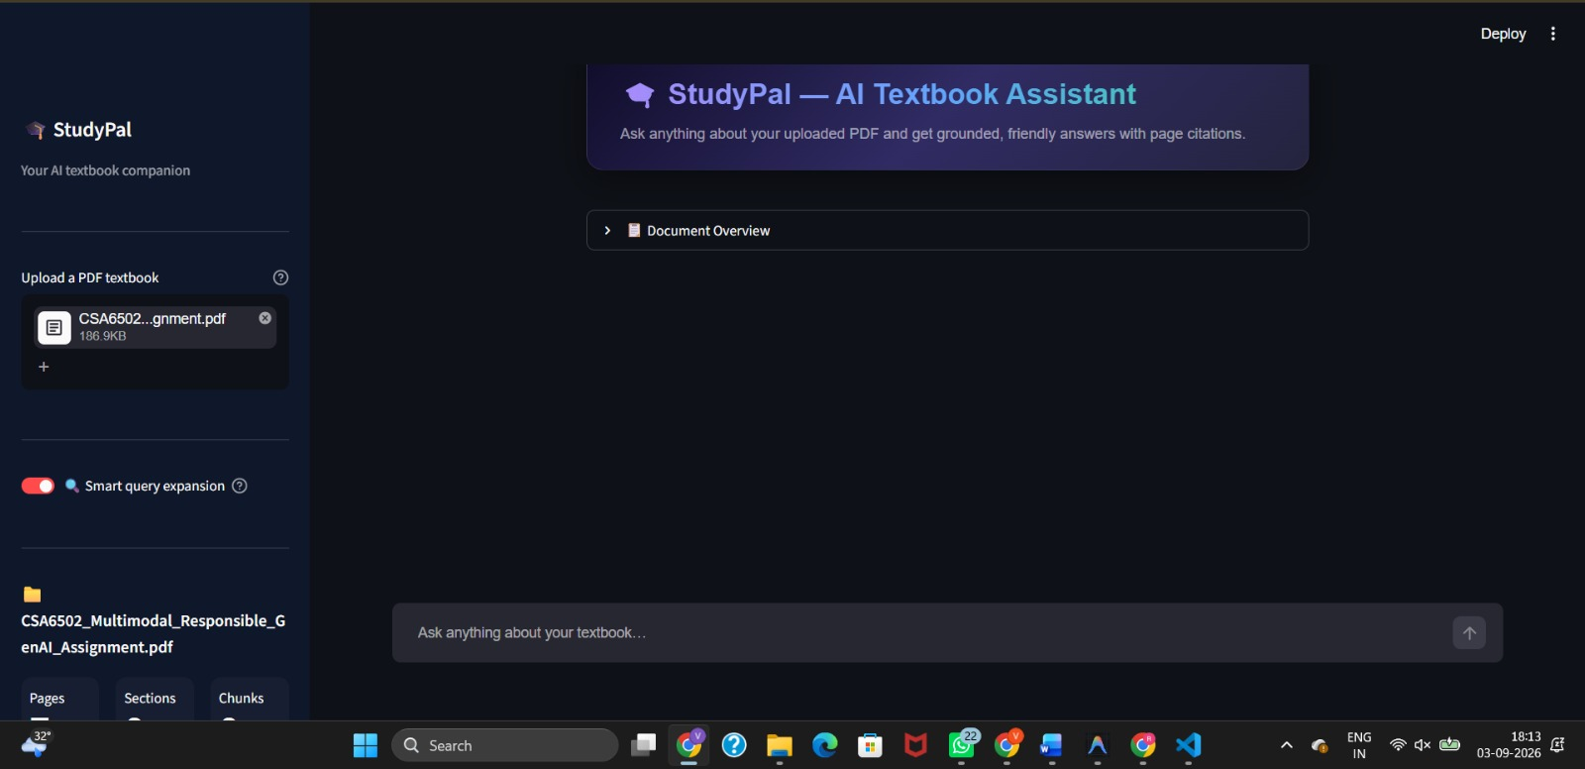
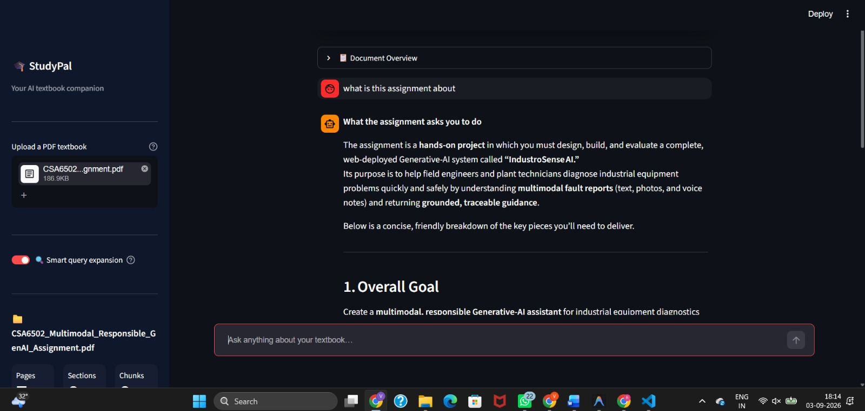
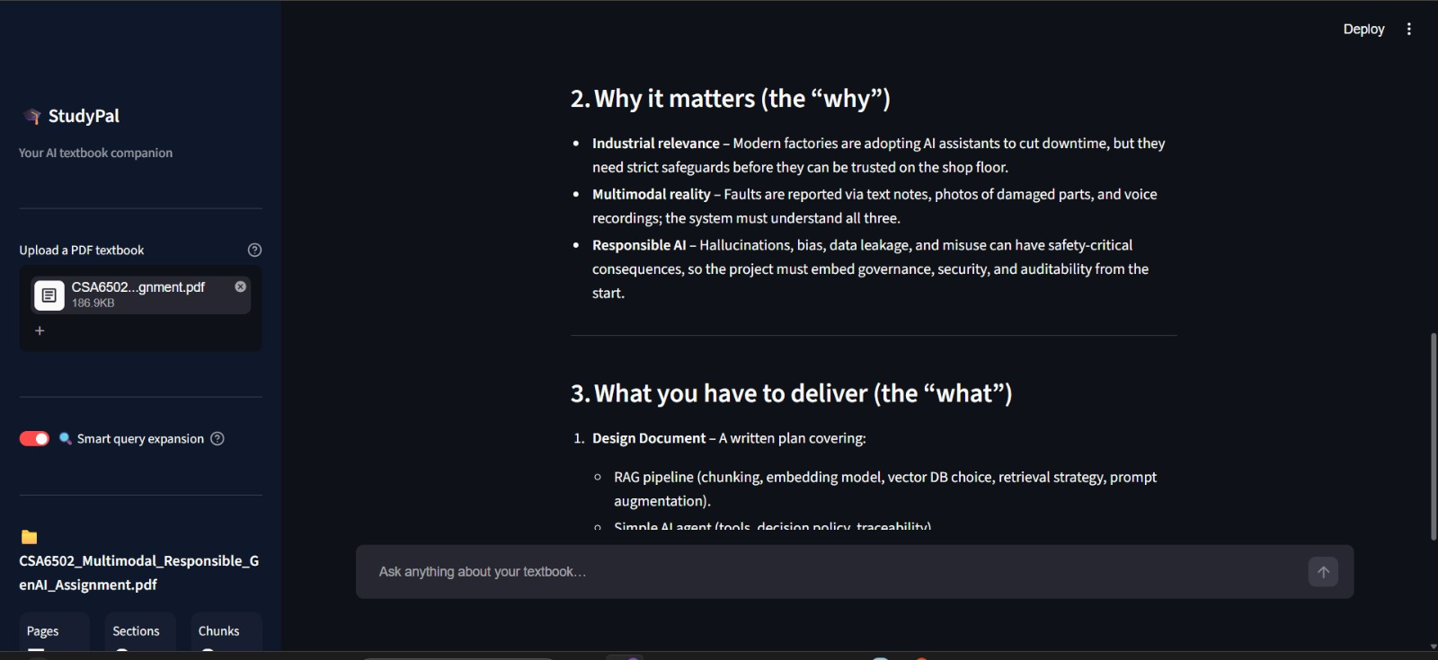
IMPLEMENTATION

Slide 13
CONCLUSION
The proposed RAG system provides an effective approach for question answering over course materials.
It combines the strengths of semantic retrieval and LLM-based text generation.
Students can obtain relevant answers without manually searching through multiple documents.
Grounding the generated responses in course materials can improve accuracy and reliability.
The system can serve as a useful AI-powered educational assistant for students and instructors.

Slide 14
FUTURE SCOPE
Multimodal Support: Extend the RAG system to understand text, images, tables, and diagrams in course materials.
Personalized Learning: Provide customized answers, explanations, and study recommendations based on individual student needs.
Voice-Based Question Answering: Allow students to ask questions through voice and receive interactive responses.
LMS Integration: Integrate the system with Learning Management Systems to provide a centralized AI-powered learning assistant.

Slide 15
REFERENCES
Wang et al. (2024) – Searching for Best Practices in Retrieval-Augmented Generation. EMNLP 2024. The paper studies different RAG strategies to improve retrieval quality and answer generation.
Alawwad et al. (2025) – Enhancing Textual Textbook Question Answering with Large Language Models and Retrieval-Augmented Generation. Pattern Recognition. The research demonstrates the effectiveness of RAG and LLMs for answering questions from textbook content.
Li et al. (2025): RAG improves educational question answering by providing relevant and reliable answers from course materials, but challenges such as hallucination and incomplete retrieval remain.
Guan et al. (2026) – EduChatQA: Curriculum-Aware Hybrid Retrieval and Teacher-Aligned Prompting for Textbook-Grounded Educational Question Answering. The research focuses on improving educational QA through curriculum-aware retrieval and grounded responses.

Slide 16


